Slide 1
final project
Group6
Team members：
Junkai Eric Xie
Dongwei Wang
Tony Wayne Wang
Guanhao Wang

Slide 2
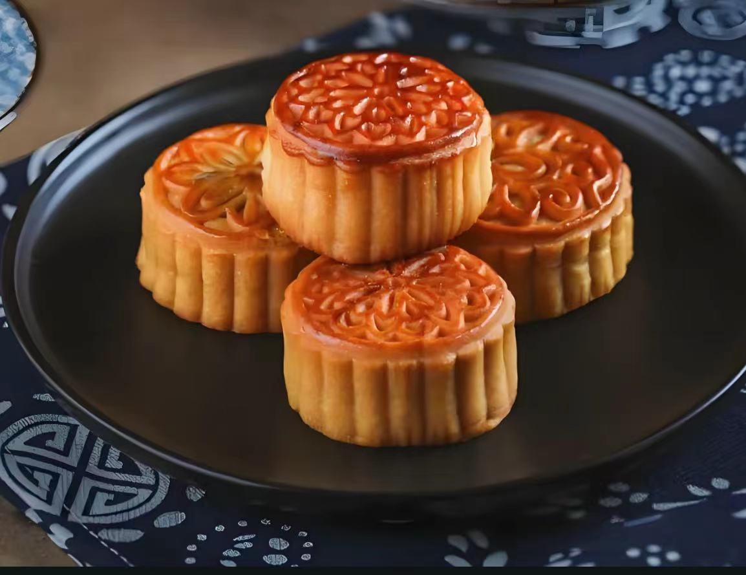
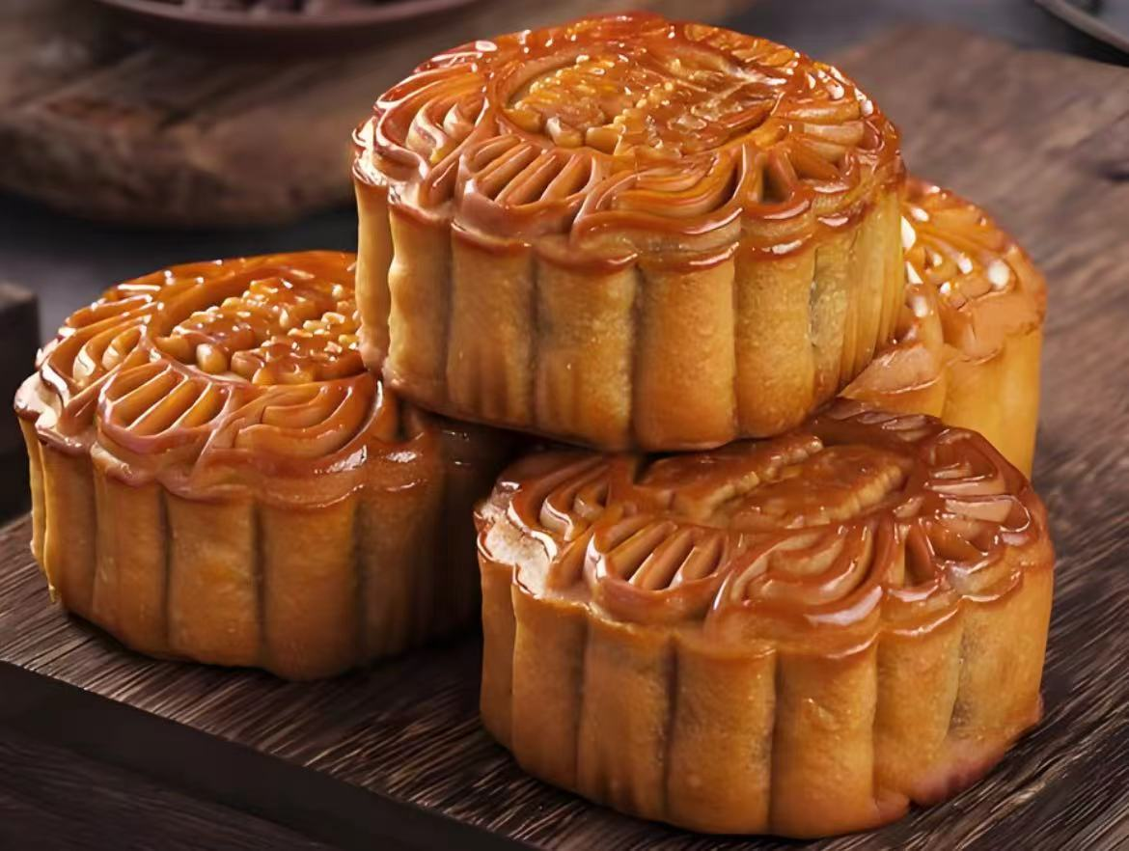
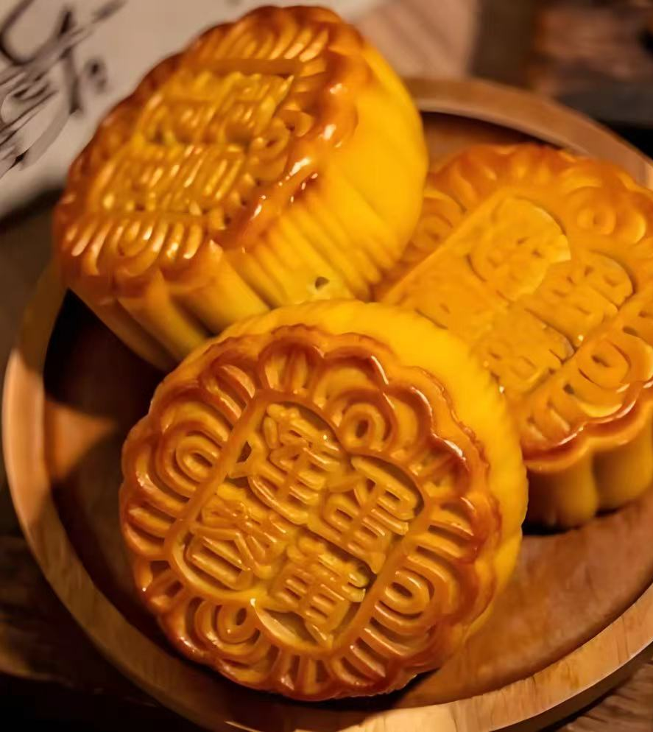
ABOUT PROJECT
Mooncake is one of the representative foods in Chinese traditional culture. The core goal of this project is to use OpenSCAD to build a highly detailed 3D model of a mooncake, and text engravings. Through accurate geometric modeling, we hope to reproduce the real appearance of the mooncake in the digital world.

Slide 3
RESPONSIBLE PART OF PROJECT
Kaijun Xie:
1. Scene construction: THREE.js was used to create a 3D scene, including model import, material adjustment, lighting settings, etc., to make the scene more realistic and immersive.
2. Animation implementation: The animation system of THREE.js is used to realize the dynamic effects such as moving, rotating, scaling and so on.
Dongwei Wang:
PPT Production and Report Rectification Adjust the logic of the article to make the content of the report more fluent and ensure that the paragraphs connect naturally. Modify the wording to make the presentation more precise and professional and enhance readability.

Slide 4
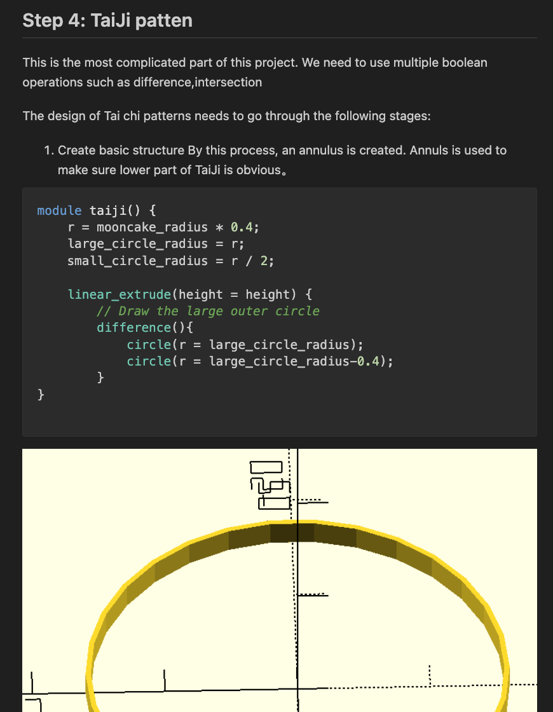
Tony Wayne Wang
1. Modeling:
Using openSCAD to make the mooncake adding decoration and adjusting 3D models
2. Creation of support documentation:
Creating a markdown file called “explain.md” clearly demonstrate the code and the process of making the moon cake
Guanhao Wang:
1. Adjust 3D models and optimize material mapping in the scene: Ensure rich details while reducing resource consumption and improving rendering performance.
2. Add background elements:
Control the particle movement trajectory through speed, size, and color changes to make it match the ambience, such as floating dust, slowly rising fog, and so on.

Slide 5
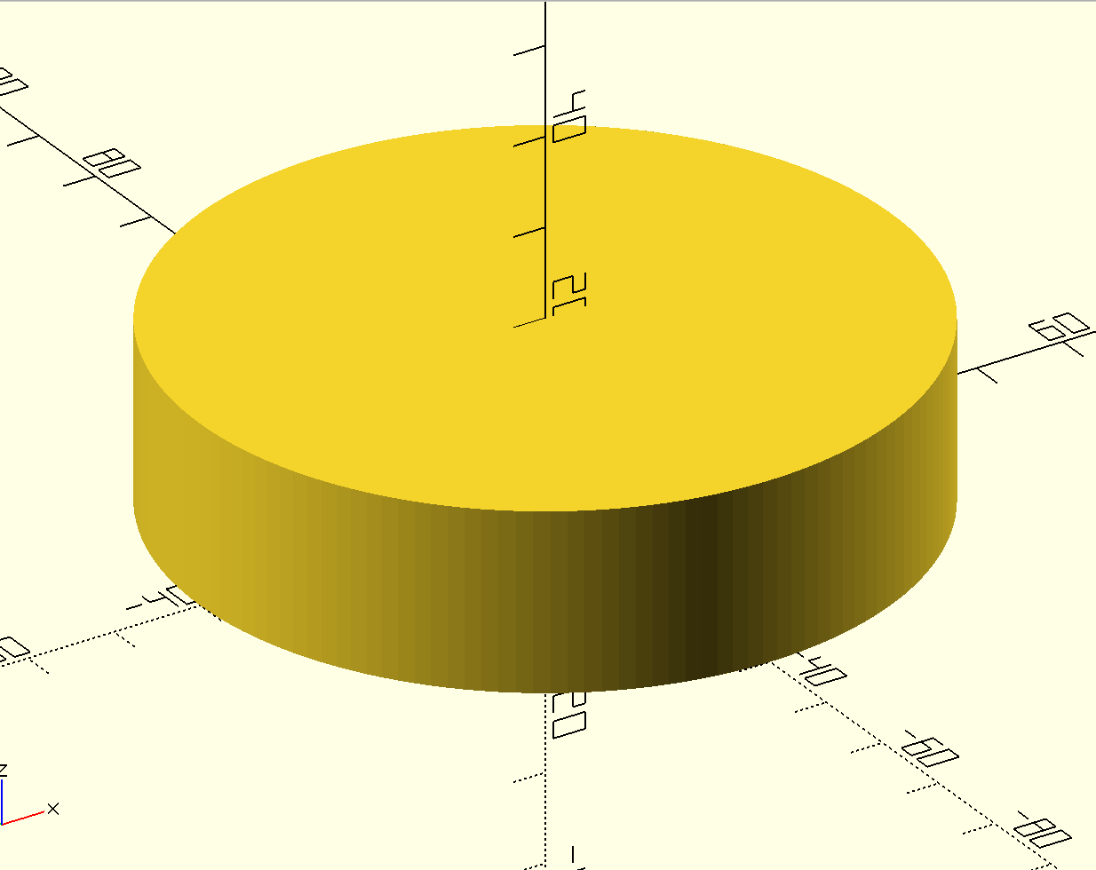
MODELING PROCESS
Step 1: Create the Mooncake Body
In this step, we will create the basic shape of the mooncake, which is a cylinder.

Slide 6
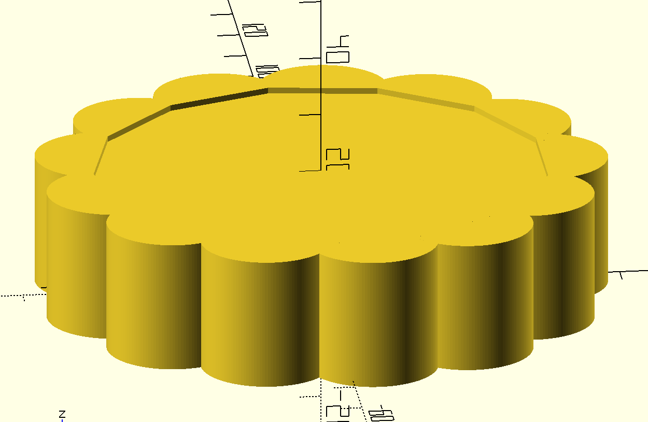
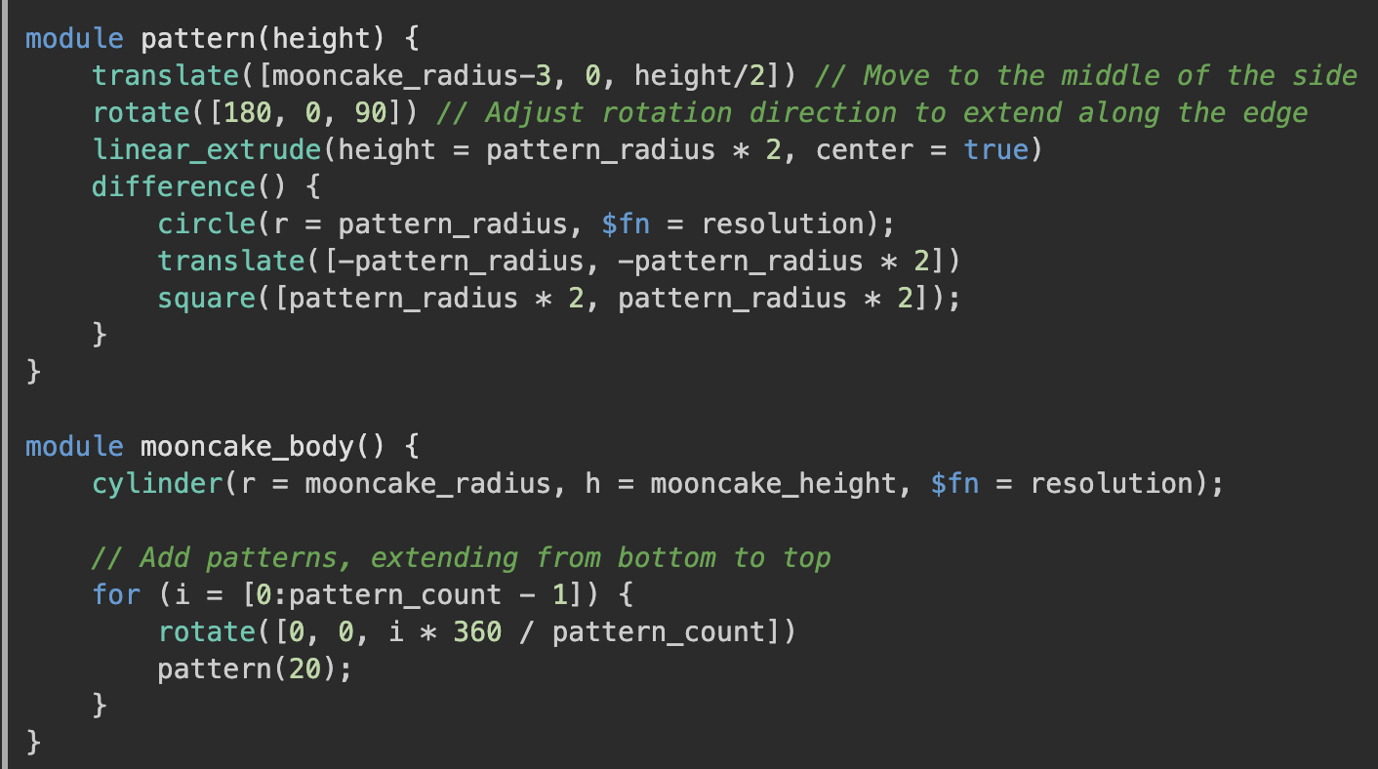
Step 2: Add Patterns surrounding the cylinder

Slide 7
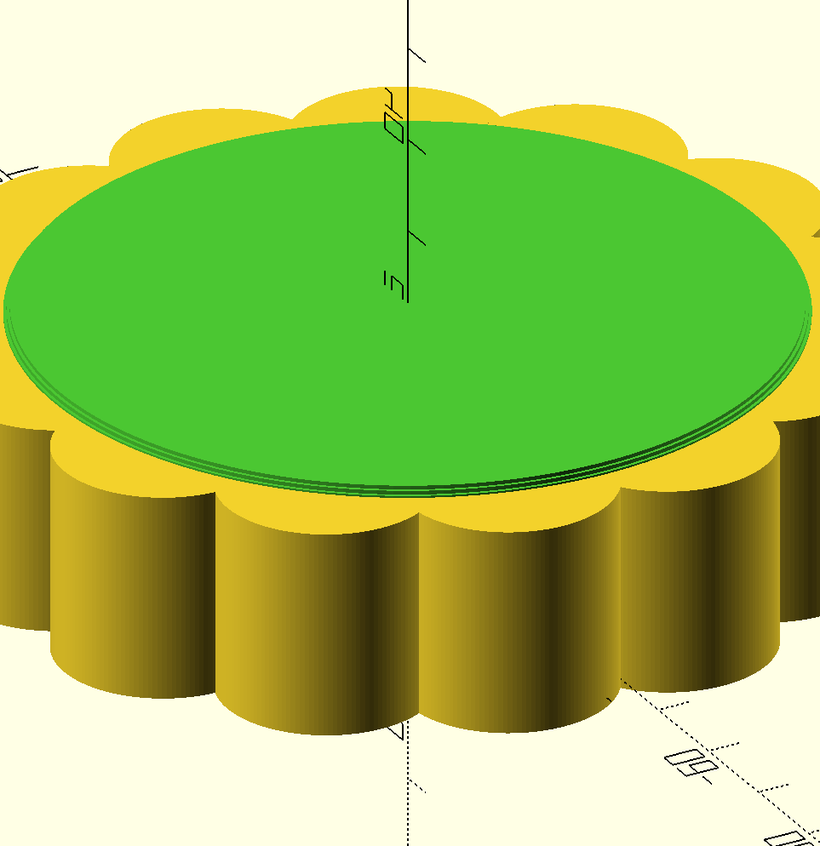
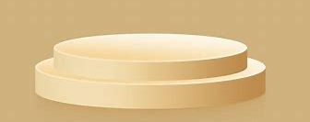
Step 3: Adding Top Patten
In this process, create a circular truncated cone at the top of cylinder. It is done by adding multiple tiny cylinder

Slide 8
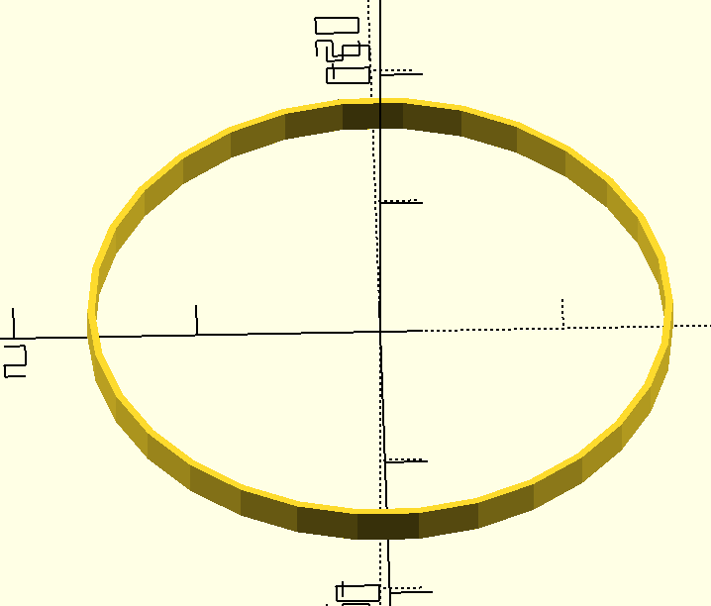
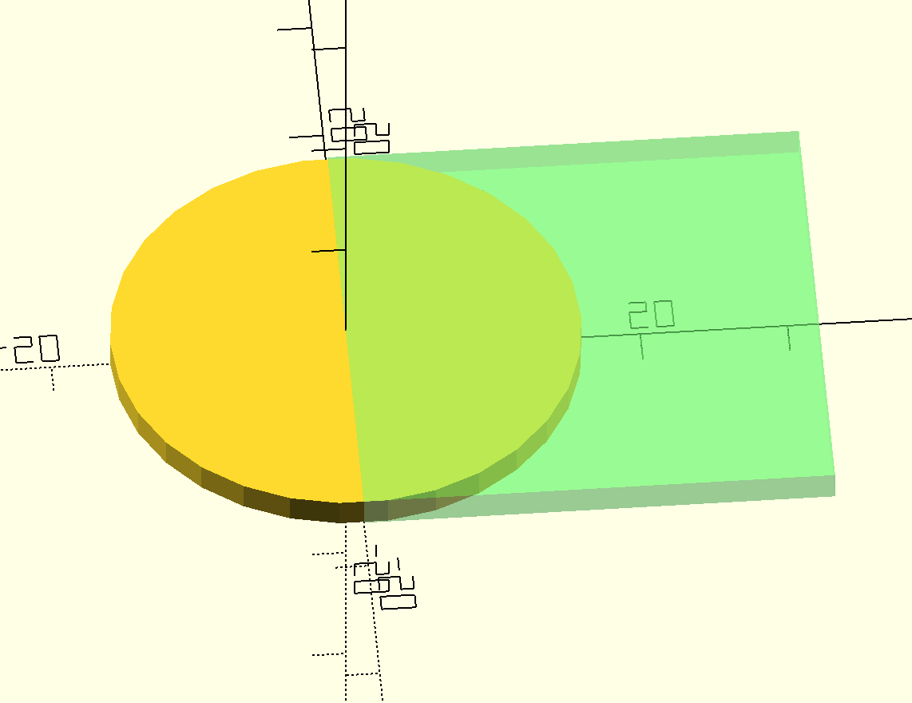
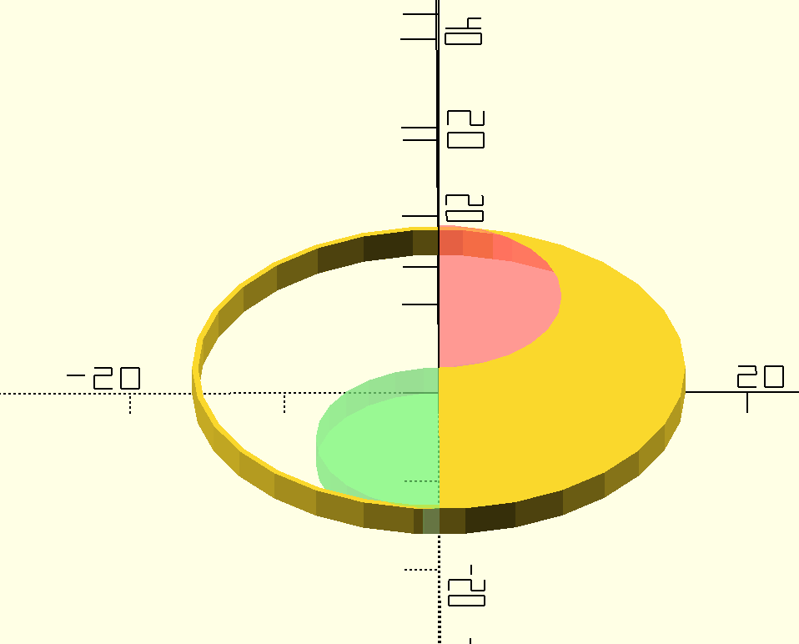
Step 4: TaiJi patten
This is the most complicated part of this project. We need to use multiple boolean operations such as Union, Difference, and Intersection
1.ring creation
2.half circle creation
3.Union and difference of two small circle

Slide 9
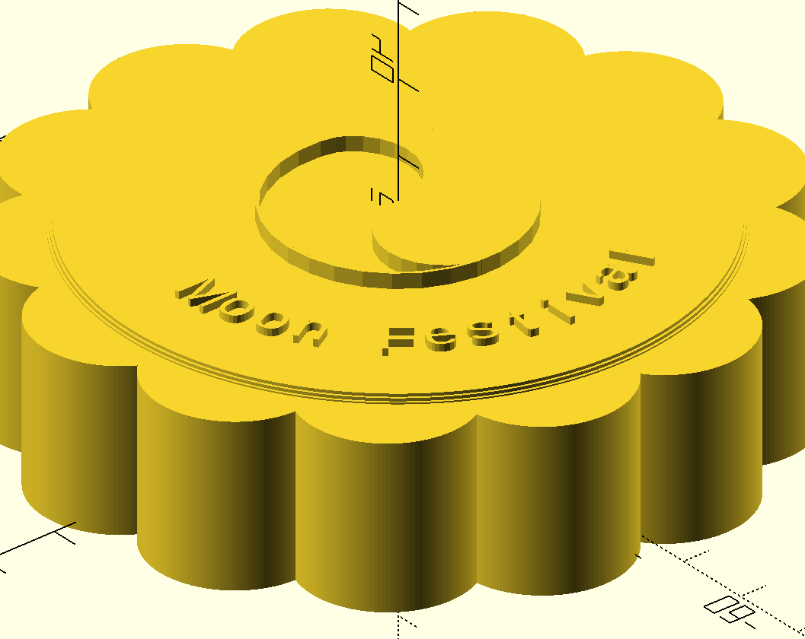
Step 5:Finish Up
Adding some text on it, and render, we can get this image about mooncake.

Slide 10
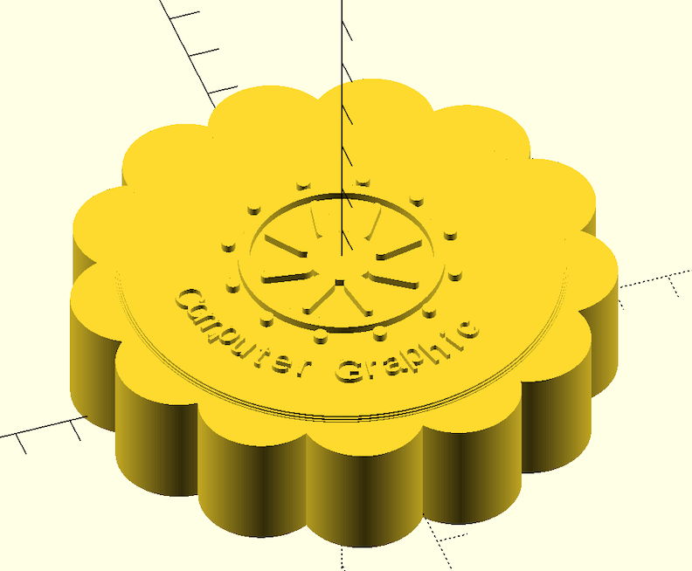
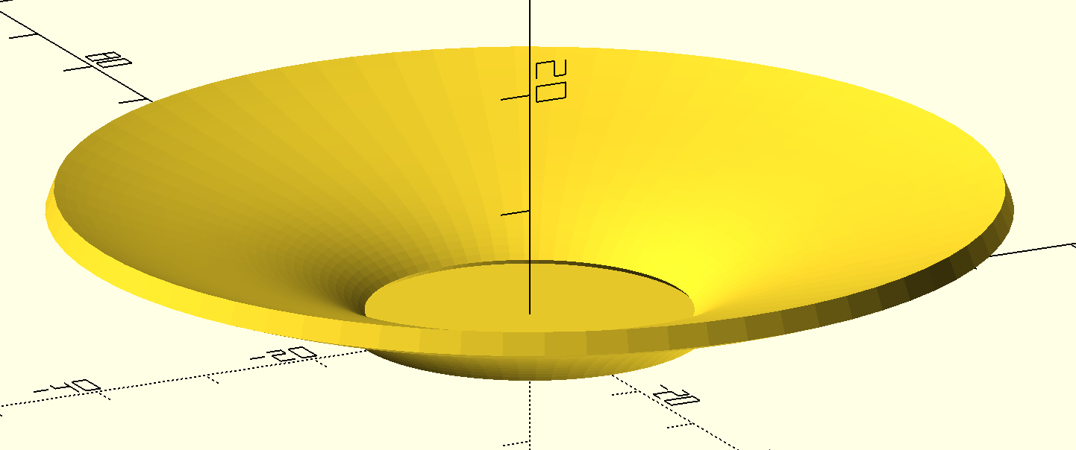
Step 6: other models
1.Plate creation
Using a library called BOSL2 to construct ﻿Bezier curve and rotate it around the z-axis
2.Another moon cake
Detailed code and steps can be seen at https://github.com/TonyWang20/MoonCake

Slide 11
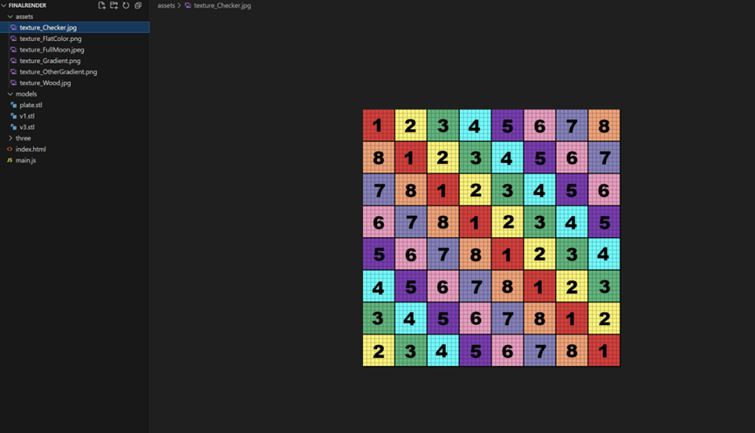
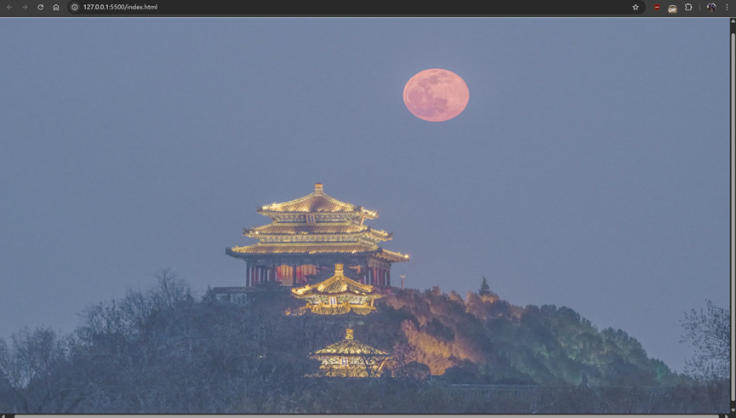
RenDering
Step 1-2
Create project framework and
THREE.js scene initialization
UV Checker Texture example
Initialized scene without models

Slide 12
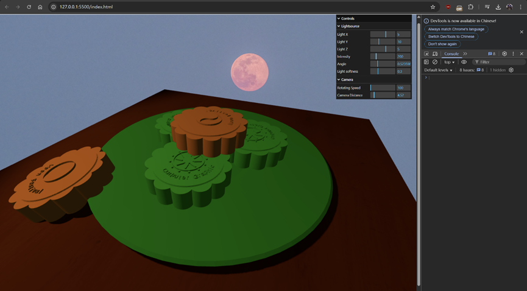
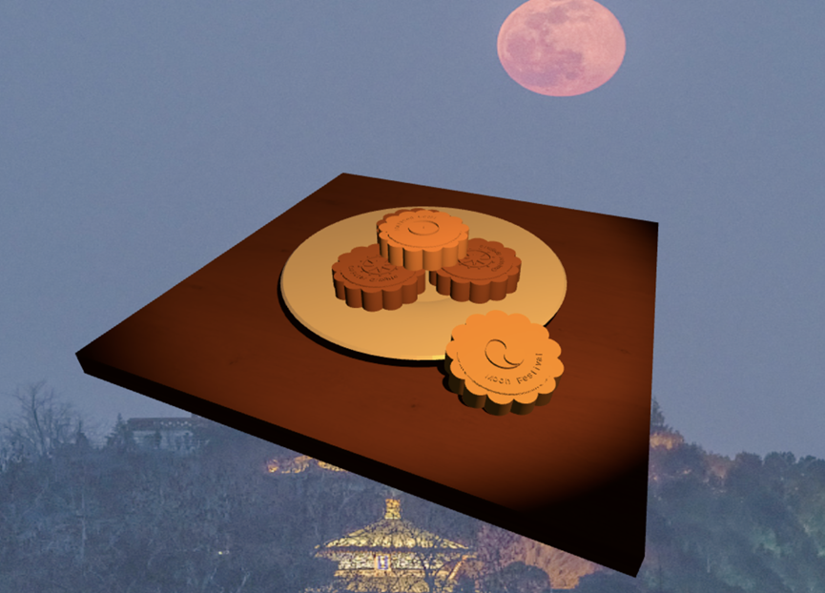
Step 3: Adding models/geometries to the new scene
with the scene initialized, we write code to add 3D objects into the scene. The code below showcases the initialization of both the table and 3 mooncakes.

Slide 13
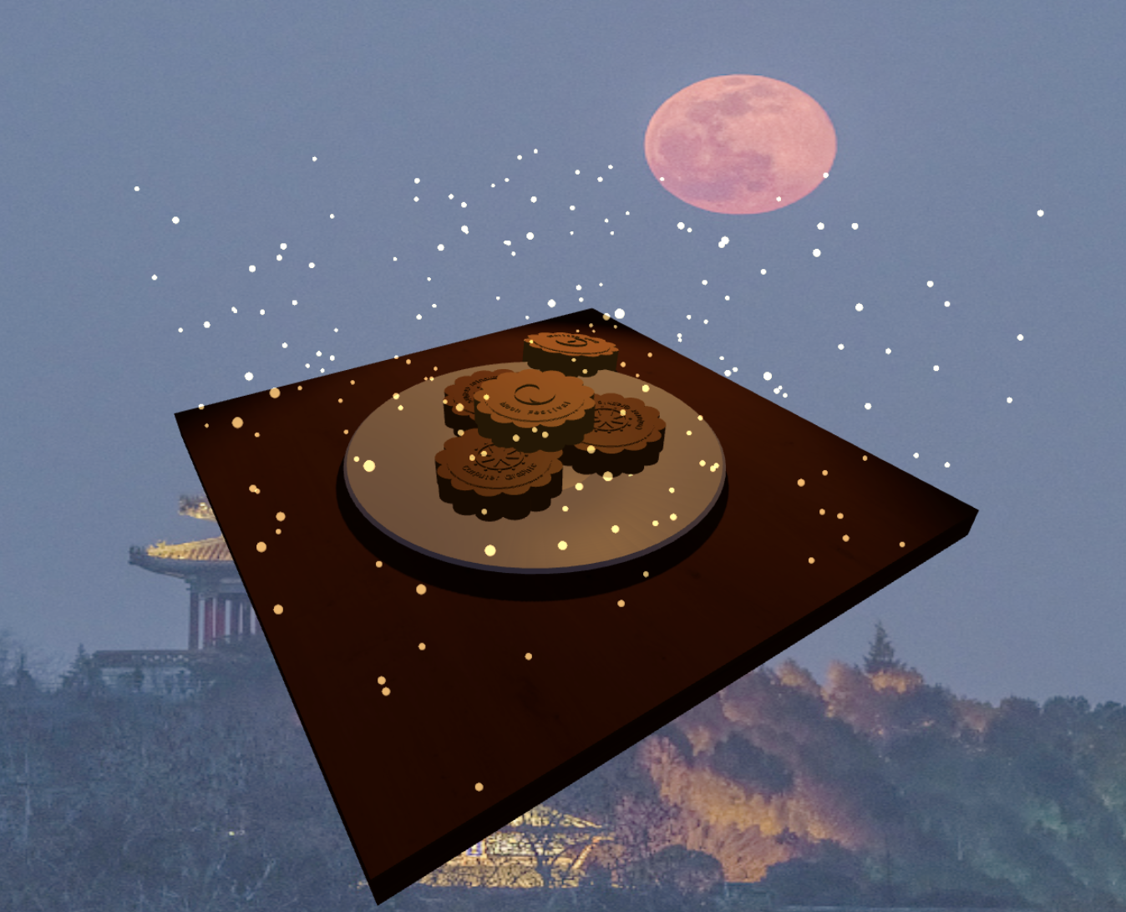
Step 4: Making the turntable animation & PARTICLE EFFECT
The scene at this stage presents as follows, with parameters altered using the GUI controls:

Slide 14
Thank you for listening.
Are there any questions?

